Slide 1
UNIT III
Shared Variables & Spark GraphX
Detailed theory + clear intuition + executable Scala examples

Slide 2
PART 1: Shared Variables in Spark

Slide 3
The Problem with Normal Variables
By default, when you refer to a variable in a Spark operation (like map or filter), Spark ships a separate, serialized copy of that variable to each task on the worker nodes. This means:
No updates are propagated: Changes made to the copy of a variable on a worker node are not visible to other tasks or back in the driver program.
Inefficient for large data: Repeatedly shipping the same large dataset with every single task creates significant network overhead and memory inefficiency.

Slide 4
1. Why Shared Variables are Needed?
In Spark:
Tasks run in parallel on different executors Each executor has its own memory space Normal variables are copied to each task
Problem:
Repeated data transmission Increased network overhead Inefficient memory usage
Solution:
Spark provides Shared Variables.

Slide 5
2. Types of Shared Variables
Spark supports two types:
Broadcast Variables (Read-only)
Accumulators (Write-only)
These help optimize distributed computation.

Slide 6
Broadcast Variables

Slide 7
3. Broadcast Variables – Theory
A Broadcast Variable:
Is a read-only variable
Sent once to all executors Stored in distributed memory Avoids repeated data transfer
Used for:
Lookup tables Configuration data Reference datasets
Cached and available on all nodes in a cluster.
Use case:
You have a small lookup table (e.g., country codes to country names) that needs to be used in transformations across a large dataset.
Instead of sending this lookup data with every task (which is inefficient), you broadcast it once to all worker nodes.

Slide 8
4. Broadcast Variable – Internal Working
Without broadcast:
Variable sent with every task With broadcast:
Sent once
Executors reuse local copy
This improves performance significantly in large clusters.
val broadcastVar = sc.broadcast(Array(1, 2, 3))
println(broadcastVar.value) // Reference to the object
broadcastVar.value returns the actual object you broadcasted.
In Scala/Java, calling println on an array prints its memory reference (default toString()), not its contents.
How to print the actual contents
println(broadcastVar.value.toList) // Converts to List and prints nicely

Slide 9
5. Broadcast Variable – Example
Problem:
Map product IDs to prices using a lookup table.
val priceMap = sc.broadcast(Map(
"P1" -> 100,
"P2" -> 200,
"P3" -> 300,
))
val products = sc.parallelize(List("P1", "P2", "P1","P3"))
val result = products.map(p => priceMap.value(p))
result.collect()
Explanation:
priceMap.value accesses broadcast data
9

Slide 10
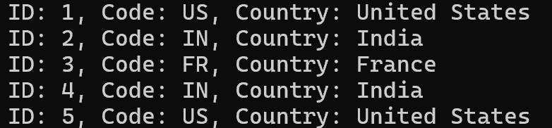
// Large dataset simulation (RDD)
val data = Seq(
(1, "US"),(2, "IN"),(3, "FR"),(4, "IN"),(5, "US")
)
val rdd = sc.parallelize(data)
// Small lookup map to broadcast
val countryLookup = Map(
"US" -> "United States","IN" -> "India","FR" -> "France"
)
// Broadcast the lookup map
val broadcastLookup = sc.broadcast(countryLookup)
// Map transformation using broadcast variable
val mappedRDD = rdd.map { case (id, code) =>
val countryName = broadcastLookup.value.getOrElse(code, "Unknown")
(id, code, countryName)
}
// Collect and print results
mappedRDD.collect().foreach {
case (id, code, name) =>
println(s"ID: $id, Code: $code, Country: $name")
}

Slide 11
Accumulators
10

Slide 12
6. Accumulators – Theory
An Accumulator:
Is a write-only shared variable
Executors can add values
Only driver can read final value
Used for:
Counters Metrics
Error tracking

Slide 13
7. Accumulator – Example
Problem: Count total sum of elements processed.
// Create a LongAccumulator with a name TotalSum
val acc = sc.longAccumulator("TotalSum")
// Create an RDD; Distributes the list across Spark executors.
val rdd = sc.parallelize(List(10, 20, 30, 40))
// Add each element to the accumulator
rdd.foreach(x => acc.add(x))
// Access accumulator value (only from the driver)
println(s"Total Sum from Accumulator: ${acc.value}")
Explanation:
Each executor updates accumulator Driver reads final aggregated value
val acc = sc.longAccumulator("TotalSum")
val rdd = sc.parallelize(List(10, 20, 30,40))
rdd.foreach(x => acc.add(x))
acc.value

Slide 14
8. Broadcast vs Accumulator
Feature | Broadcast | Accumulator
Access | Read-only | Write-only
Direction | Driver → Executors | Executors → Driver
Purpose | Lookup data | Counters

Slide 15
Feature / Aspect | Broadcast Variable | Accumulator
Purpose | Share read-only data efficiently across all worker nodes without sending it with every task. | Aggregate values across tasks (e.g., counters, sums) in a write-only manner from executors to the driver.
Mutability | Immutable (read-only) after creation. | Mutable only through associative and commutative operations (e.g., addition).
Direction of Data Flow | Driver → Executors (data is sent once and cached on each executor). | Executors → Driver (values are aggregated back to the driver).
Use Case | Distribute large lookup tables, configuration data, or reference datasets to all tasks. | Counting events, summing metrics, debugging, or tracking progress.
Data Size | Can hold large datasets (but should fit in memory of each executor). | Typically small numeric or collection-based values.
Access in Executors | Read-only access in all tasks. | Tasks can only update; cannot read the current value during execution.
Performance Impact | Reduces network overhead by avoiding repeated data transfer. | Minimal overhead for numeric aggregation; not for large data.
Fault Tolerance | Automatically re-sent to executors if they fail. | Updates are not guaranteed to be exactly-once in case of task retries (may overcount).
API Example (PySpark) | sc.broadcast(data) | sc.accumulator(0) or sc.longAccumulator()

Slide 16
PART 2: Introduction to Spark GraphX

Slide 17
9. What is Graph Analytics?
A Graph consists of:
Vertices (Nodes) → Entities
Edges → Relationships between entities
Examples:
Social networks Road networks Web page linking
Recommendation systems

Slide 18
10. What is Spark GraphX?
GraphX is:
A distributed graph processing library Built on top of RDDs
Designed for large-scale graph analytics
It integrates:
Graph computation
Data-parallel computation

Slide 19
Spark GraphX Features

Slide 20
11. Key Features of GraphX
Distributed graph processing
Fault tolerance using RDD lineage
In-memory graph computation
Built-in graph algorithms
Integration with Spark ecosystem

Slide 21
12. Graph Representation in GraphX
GraphX represents graph as:
Graph(VertexRDD, EdgeRDD) Where:
VertexRDD stores vertices EdgeRDD stores edges

Slide 22
Spark GraphX Operations
20

Slide 23
13. Creating a Graph
import org.apache.spark.graphx._
val vertices = sc.parallelize(Array[(Long, String)](
(1L, "Aman"),(2L, "Raman"),(3L, "Amit")
))
val edges = sc.parallelize(Array[Edge[String]]
( Edge(1L, 2L, "friend"), Edge(2L, 3L, "follow")
))
val graph = Graph(vertices, edges)
graph.edges.collect().foreach(println)
🏆 Golden Rule for Spark + REPL
If using:
Tuple types
Edge types
Generic collections
👉 Prefer Seq(...) over Array(...).

Slide 24
14. Accessing Graph Data
graph.vertices.collect() graph.edges.collect()
Returns all nodes and relationships

Slide 25
15. Graph Triplets
Triplet = (Source Vertex, Edge, Destination Vertex)
graph.triplets.collect()
Useful for relational analysis.

Slide 26
16. Degree Calculation
graph.degrees.collect()
Returns:
(vertexId, degree)
Degree = Number of connections of a vertex.

Slide 27
// Import GraphX library
// GraphX is a component of Apache Spark used for graph processing.
// It provides classes like Graph, Edge, VertexId, and graph operations.
import org.apache.spark.graphx._
// Create vertices RDD
// Each vertex is a tuple: (VertexId, VertexAttribute)
// VertexId must be of type Long; Here:
// Vertex ID = 1 (as Long) -> Vertex Attribute = "Aman"
// 1L -> Aman
// 2L -> Raman
// 3L -> Amit
val vertices = sc.parallelize(Seq(
(1L, "Aman"),(2L, "Raman"),(3L, "Amit")
))

Slide 28
// Create edges RDD
// Edge(sourceVertexId, destinationVertexId, edgeAttribute)
// 1L -> 2L with relationship "friend"
// 2L -> 3L with relationship "follow"
// In GraphX, the vertex ID type is: type VertexId = Long
val edges = sc.parallelize(Seq(
Edge(1L, 2L, "friend"),
Edge(2L, 3L, "follow")
))
// Create Graph object
// Graph[VD, ED]
// VD = Vertex Data Type (String here: name)
// ED = Edge Data Type (String here: relationship type)
val graph = Graph(vertices, edges)

Slide 29
// Display all vertices
// Returns: (VertexId, VertexAttribute)
graph.vertices.collect().foreach(println)
// Display all edges
// Returns: Edge(srcId, dstId, edgeAttr)
graph.edges.collect().foreach(println)
// Display degree of each vertex
// Degree = number of connections (incoming + outgoing)
graph.degrees.collect().foreach(println)
// Display triplets (very important)
// Triplet contains:
// (sourceId, sourceAttr, destinationId, destinationAttr, edgeAttr)
// This gives full relationship view
graph.triplets.collect().foreach(println)

Slide 30
Feature Extraction and Transformation

Slide 31
17. What is Feature Extraction?
Feature extraction:
Converts graph structure into numeric features Used for analytics and machine learning
Examples:
Degree
In-degree
Out-degree
PageRank
Connected components
Triangle count

Slide 32
18. Example: Extracting Degree Feature
val degrees = graph.degrees
degrees.collect().foreach(println)
This gives numeric representation of node importance.
Output:
(1,1)
(2,2)
(3,1)
Feature Meaning:
Vertex 2 (Raman) is more connected

Slide 33
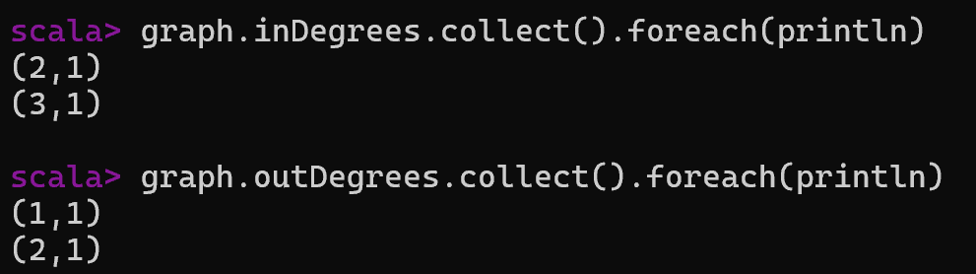
19. Example: Extracting In-Degree & Out-Degree Feature
graph.inDegrees.collect().foreach(println)
graph.outDegrees.collect().foreach(println)
Now you have directional features.

Slide 34
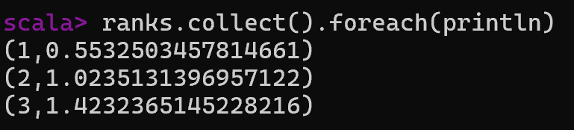
20. Example: Extracting PageRank Feature
val ranks = graph.pageRank(0.01).vertices
ranks.collect().foreach(println)
Now each node has an importance score.
This is advanced feature extraction.
PageRank is a link analysis algorithm that assigns a numerical weight (importance score) to each node in a graph based on the quantity and quality of incoming links.
Developed by Google founders, it calculates a node's rank recursively

Slide 35
21. Feature Transformation
Feature transformation modifies extracted features for analysis. Example: Scaling degree values.
degrees.mapValues(d => d* 10).collect()
degrees.collect()
Used for:
Normalization
Weight adjustment
Analytical modeling
We use:
mapVertices
mapEdges
outerJoinVertices

Slide 36
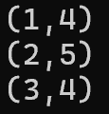
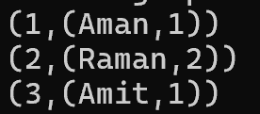
21. Feature Transformation Contd…
Feature transformation modifies extracted features for analysis.
val transformedGraph = graph.mapVertices {
case (id, name) => name.length
}
transformedGraph.vertices.collect().foreach(println)
Now feature = name length.
val graphWithDegree = graph.outerJoinVertices(graph.degrees) {
case (id, name, degreeOpt) =>
(name, degreeOpt.getOrElse(0))
}
graphWithDegree.vertices.collect().foreach(println)
Now vertex contains:
(Name, Degree)
This is feature transformation.

Slide 37
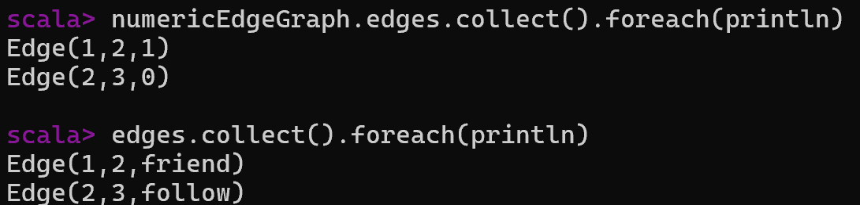
✅ 21. Transform Edge Feature contd…
Convert relationship into numeric:
val numericEdgeGraph = graph.mapEdges { edge =>
if (edge.attr == "friend") 1 else 0
}
numericEdgeGraph.edges.collect().foreach(println)
Now edges become numeric.

Slide 38
20. Why Feature Extraction is Important?
Converts graph into ML-ready format Enables predictive modeling
Supports fraud detection & recommendations
Raw Graph
↓
Feature Extraction
↓
Feature Transformation
↓
ML Model

Slide 39
Final Summary
Shared variables optimize distributed execution Broadcast → efficient lookup
Accumulators → distributed counters GraphX enables large-scale graph analytics
Feature extraction transforms graph structure into numeric insights
30

Slide 40
Exercise: Creating a Property Graph
Task: Create a graph representing a small social network.
Vertices: (1, "Alice", 28), (2, "Bob", 27), (3, "Charlie", 65), (4, "David", 42).
Edges: Alice likes Bob, Bob likes Charlie, Charlie likes Alice, David likes Alice.
Requirement: Output the total number of vertices and edges.
val users= sc.parallelize(Array
[(Long, (String, Int))](
(1L, ("Alice", 28)),(2L, ("Bob", 27)),
(3L, ("Charlie", 65)),(4L, ("David", 42))
))
val users: RDD[(VertexId, (String, Int))] = sc.parallelize(Array(
(1L, ("Alice", 28)), (2L, ("Bob", 27)),
(3L, ("Charlie", 65)), (4L, ("David", 42))
))
Use case: Works fine for general Spark RDD operations. You can still use this in GraphX, because GraphX internally expects vertex IDs as Long
Use case: Preferred when working with GraphX, because it makes your code semantically clear — you’re not just using a Long, you’re using a VertexId that represents a vertex in a graph.

Slide 41
Aspect | Long version | VertexId version
Type | Plain Long | Alias VertexId (which is Long)
Semantics | Generic numeric ID | Explicitly a GraphX vertex identifier
Readability | Looks like a normal RDD of tuples | Makes it clear you’re working with GraphX
Functionality | Works fine in Spark and GraphX | Recommended in GraphX for clarity and type safety

Slide 42

Solution 1:
import org.apache.spark.graphx._
import org.apache.spark.rdd.RDD
// 1. Define Vertices
val users: RDD[(VertexId, (String, Int))] = sc.parallelize(Array(
(1L, ("Alice", 28)),
(2L, ("Bob", 27)),
(3L, ("Charlie", 65)),
(4L, ("David", 42))
))
// 2. Define Edges (SourceID, DestID, Relationship)
val relationships: RDD[Edge[String]] = sc.parallelize(Array(
Edge(1L, 2L, "likes"),
Edge(2L, 3L, "likes"),
Edge(3L, 1L, "likes"),
Edge(4L, 1L, "likes")
))
// 3. Build Graph
val graph = Graph(users, relationships)
// 4. Verification
println(s"Vertices: ${graph.vertices.count()}")
println(s"Edges: ${graph.edges.count()}")

Slide 43
Exercise 2: Graph Filtering and Transformation
Task: Using the graph from Exercise 1:
Find all users older than 30.
Find all "likes" relationships where the source user is older than the destination user.

Slide 44
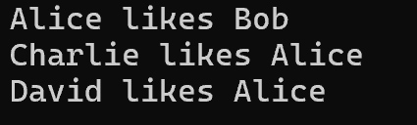
Solution 2:
// 1. Filter Vertices
val olderUsers = graph.vertices.filter { case (id, (name, age)) => age > 30 }.collect()
// 2. Filter Edges using Triplets
// Triplets allow access to both source and destination attributes simultaneously
val olderToYounger = graph.triplets.filter(t => t.srcAttr._2 > t.dstAttr._2)
olderToYounger.collect().foreach(t => println(s"${t.srcAttr._1} likes ${t.dstAttr._1}"))

Slide 45
Exercise 3: PageRank Algorithm
Task: Run the PageRank algorithm on the social network to find the most "influential" user.

Slide 46
Solution 3:
// Run PageRank with a tolerance of 0.001
val ranks = graph.pageRank(0.001).vertices
// Join ranks with user names for readable output
val usersWithRank = ranks.join(users).map {
case (id, (rank, (name, age))) => (name, rank)
}
usersWithRank.collect().sortBy(-_._2).foreach(println)

Slide 47
📘 Exercise Task: Company Hierarchy Analysis
Scenario
Create a dataset of employees and their reporting relationships. Each employee has:
A vertex ID (unique number).
A name and department. Relationships are directed edges showing who reports to whom.
Tasks
Count employees and reporting lines.
List all employees in the IT department.
Find the in‑degree (number of direct reports) of each manager.
Find the out‑degree (number of managers each employee reports to).
Identify connected components (groups of employees connected in the hierarchy).

Slide 48
Dataset
// Vertices (Employees)
import org.apache.spark.graphx._
import org.apache.spark.rdd.RDD
val employees: RDD[(VertexId, (String, String))] = sc.parallelize(Array(
(1L, ("Alice", "HR")),
(2L, ("Bob", "IT")),
(3L, ("Charlie", "Finance")),
(4L, ("David", "IT")),
(5L, ("Eva", "HR"))
))
// Edges ((Reporting Lines))
val reports: RDD[Edge[String]] = sc.parallelize(Array(
Edge(2L, 1L, "reports_to"), // Bob → Alice
Edge(3L, 1L, "reports_to"), // Charlie → Alice
Edge(4L, 2L, "reports_to"), // David → Bob
Edge(5L, 1L, "reports_to") // Eva → Alice
))

Slide 49
1. Build Graph
val graph = Graph(employees, reports)
2. Count Employees and Reporting Lines
println(s"Employees: ${graph.vertices.count()}")
println(s"Reporting lines: ${graph.edges.count()}")
Output:
Employees: 5
Reporting lines: 4
3. Employees in IT Department
graph.vertices.filter { case (_, (name, dept)) => dept == "IT" }
.collect()
.foreach(println)
Output:
(2,(Bob,IT))
(4,(David,IT))

Slide 50
4. In-Degree (Managers with Direct Reports)
graph.inDegrees.collect().foreach(println)
Output:
(1,3) // Alice has 3 direct reports
(2,1) // Bob has 1 direct report
5. Out-Degree (Employees Reporting to Managers)
graph.outDegrees.collect().foreach(println)
Output:
(2,1) // Bob reports to Alice
(3,1) // Charlie reports to Alice
(4,1) // David reports to Bob
(5,1) // Eva reports to Alice

Slide 51
6. Connected Components
graph.connectedComponents().vertices.collect().foreach(println)
Output :
(1,1)
(2,1)
(3,1)
(4,1)
(5,1)
👉 All employees are connected in one hierarchy.

Slide 52
End of Unit III
31

